Slide 1

GAMING MONITRING DEPARTMENT

Slide 2
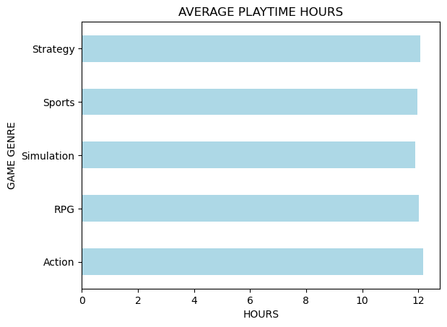
What is the average playtime (PlayTimeHours) for each game genre?

Slide 3
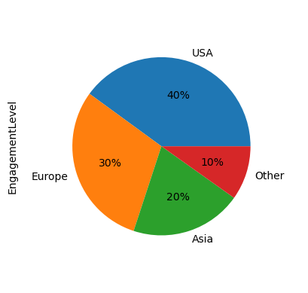
Which location has the highest average engagement level among players?

Slide 4
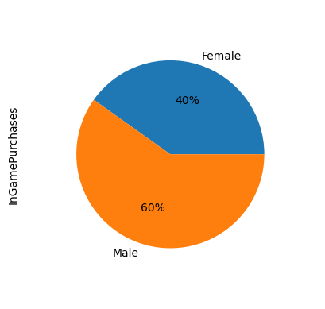
What is the average number of in-game purchases made by male vs female players?

Slide 5
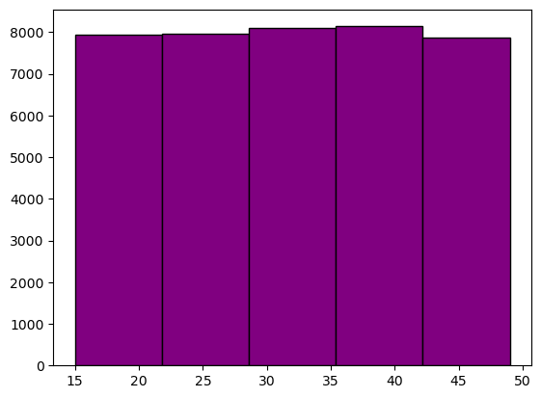
Which age group (e.g., below 20, 20–30, 30–40, above 40) spends the most time playing games?

Slide 6
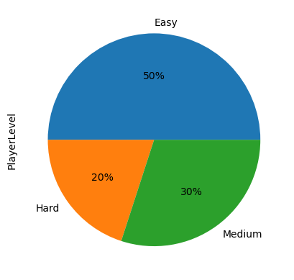
What is the distribution of game difficulty levels among all players?

Slide 7
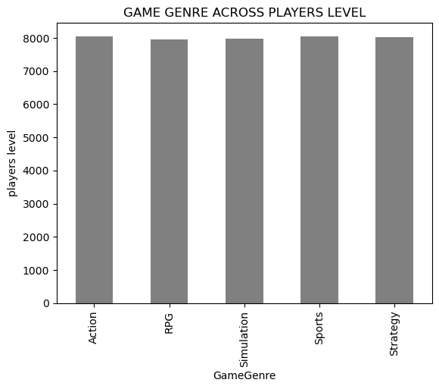
How does player level vary across different game genres?

Slide 8
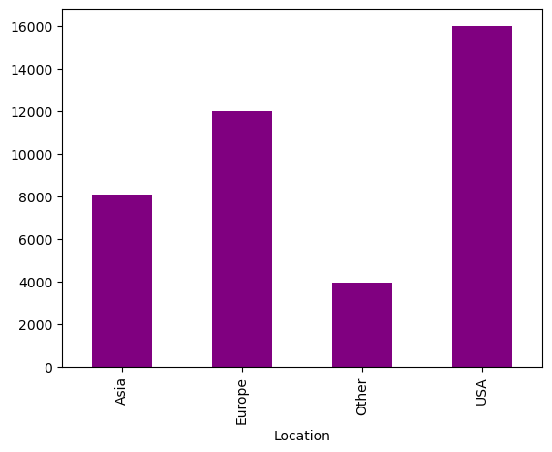
Which country or region has the highest number of high-engagement players?

